Slide 1

Rick’s
MSIS 5303 – Prescriptive Analytics
No!!! Not true!

Slide 2
Fall 2022– MSIS 5303 “CliffsRick’sNotes”
Content: Problem solving using Linear Programming.
A tool and, more importantly, …
A process to approach all problem solving.
A 16 week class in 8 16 weeks.
Summer notes: (Twice as fast, not ½ as difficult.)
2x number of optimal students
Grading nightmare but I’ll do my best.
Solutions posted before I award meticulously determined partial credit.
Quasi-Self paced ….
Give me the first 8 weeks to get most things set up for the whole 16 weeks.
(Due dates) You can do things early to fit into your schedule. Everything is ‘take-home’.
**** FALL CHECKPOINT WEEKEND SPECIAL ****
Checkpoints due on Monday – so you last minute shoppers you can use the weekend and then +24 hours where I can answer your last minute questions (ending at say 5pm on Monday).
Major things available 7-10 days ahead of time (that is my standard promise, and it will likely be available long before that).
“Do not confuse the due date with the start date” – J. Wooden quote (I wish).
Please use Canvas outline of material, not some other way. (This class is not meant to take on your phone).
No discussion board, but bulletin board and Rule #1 in subsequent Gibbs/Rick’s Rules of the class.
“About me” is mixed in with content …

Slide 3
Fall 2022 – MSIS 5303 “CliffsRick’sNotes”
Content
12 ‘blocks’ of material grouped into 4 ‘checkpoints’ (separate slide, and course map)
Material builds on itself
Process of Learning (separate slide)
On-line (only) book access (pay at publisher website).
Activities (See Course map)
Practice problems (in book)
Gold Stars (in book or Canvas)
Quizzes (in book)
Checkpoints (Exams, take-home, concepts plus contexts).
Points (see syllabus #2)
Schedule – color coded calendar, CANVAS “Syllabus” page, Course Map
“… the due date is not the start date …”.

Slide 4
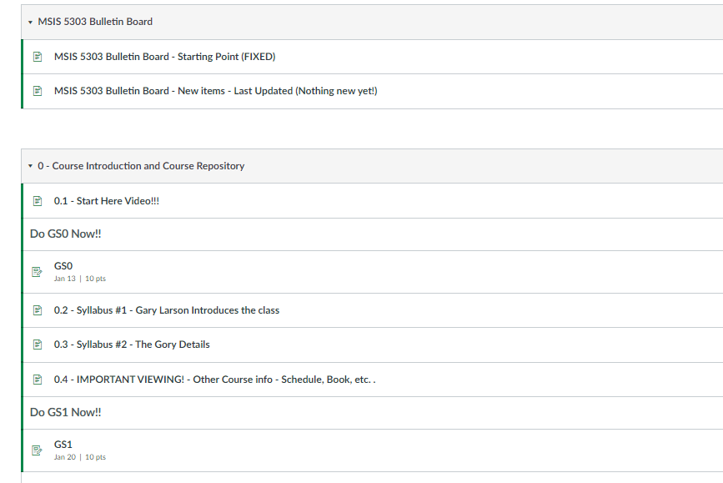
Fall 2022 – Canvas “Block 0”
Rick’sNotes
In-class exercise
“Long and winding road …”
“GibbsRick’s Rules”

Slide 5
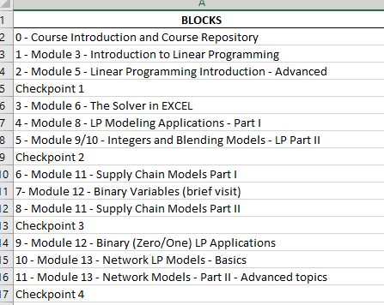
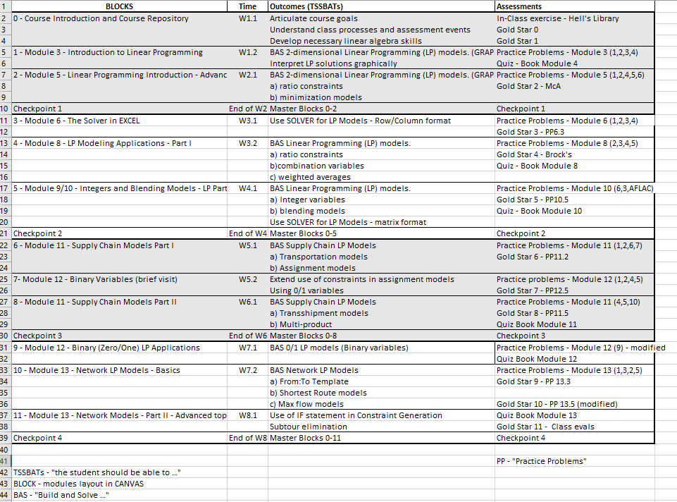

Slide 6
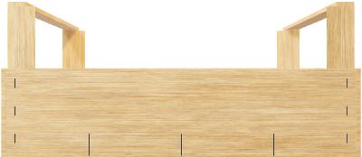
REPEAT …
Introduce new ‘tool’
“in-class activity”
Optimize with tool
Practice with tool
Assessment #1 – Practice Problems
Formal Assessment
Assessment #2 – Gold Star and/or Quiz
Master tool
UNTIL …
Toolbox
Assessment #3 – Checkpoints - Multiple tools in different ways and different contexts

Slide 7
Gold Star #0
Tell me the John Wooden quote at the end of the video – or give me your favorite John Wooden quote.
Promise (in words) to know the details of the class so there are no surprises.
Syllabus
Course Map
Course schedule – spreadsheet
Course schedule - Canvas
Thus - 10 points just to give you credit for watching the video.

